Slide 1
SHOPPING CART LIGHTNING APP
IN SALESFORCE
Presented By,
Janani Janagaraj.

Slide 2
Project
Lightning Steps is a global shoe brand company, they would like to have a single-page order placement app built with Lightning components in their Salesforce environment.
The app should contain at least these 3 main functional components.
Business Requirements
A Component to list products and to show prices and a picture of the product, with an “add to cart” button.
A Component to filter the products based on chosen attributes (e.g. category: boot, running shoe, etc.; price).
Shopping cart component to show a summary of products and a button “make an order” which will create an order record with the selected products.

Slide 3
Functional Implementation
Create a Custom Component
Create a custom component to list the products, show their prices and images, and provide an "add to cart" button. This component would need to use the custom object “Product_c”and retrieve the product information from it to display.
Create a Filter Component
Create a filter component that allows users to filter the products based on chosen attributes, such as category and price.
Create a Shopping Cart Component
Create a shopping cart component to display a summary of the products selected, including the name, price, and image of each product. The component would need to provide a button "make an order" which would create an order record in a custom object “Order_c” with the selected products.

Slide 4
Implement Business Logic
Use Apex classes to implement the business logic for the shopping cart, such as adding and removing items from the cart, calculating the total cost of the order, and creating an order record when the "make an order" button is clicked.
Apex Class
Only one Apex class we are using here in this project called ProductService.
Test the Application
Test the application to ensure that it is functioning as expected and that all components work together seamlessly.
Deploy the Application
Deploy the application to a Salesforce org for testing.
Finally, create a Lightning page to host the three components and display the app as a Standalone page in Salesforce.

Slide 5
Technical Implementation
Create the Custom Object .
Create the Lightning Web Component.

Slide 6
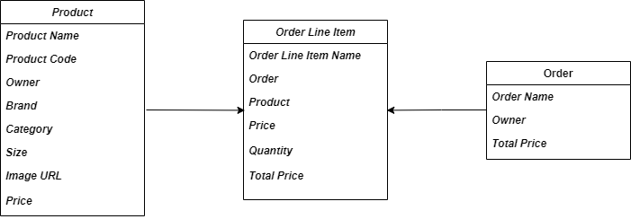
Custom Object Schema

Slide 7
Create a Custom Object
To create a custom object in Salesforce,
Go to Setup.
In the Quick Find box, type "Objects" and select Object Manager.
Click the "Create" button.
Select "Custom Object" from the dropdown menu.
Fill in the required fields: Object Name, Label, and Plural Label.
Click the "Save" button.
Your custom object will now be created and can be used to store specific data for your business needs.

Slide 8
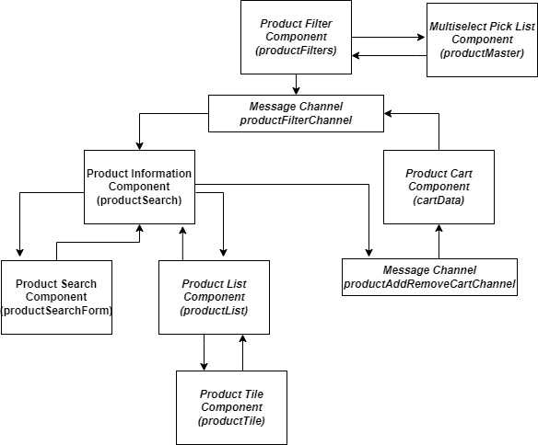
LWC Components Flowchart

Slide 9
Create a Lightning Web Components (LWC)
Go to Setup.
In the Quick Find box, type "Lightning Web Components" and select "Lightning Web Components".
Click the "New" button to create a new Lightning Web Component.
Enter a name for the component and select a folder location.
Choose the desired template or start with a blank template.
Write the HTML, JavaScript, and CSS code for the component.
Save the component.
To test the component, you can create a Lightning Page and add the component to it.
Your custom lwc component will now be created and can be used for your business needs. This component can be shared and used by other salesforce developer as well.

Slide 10
Salesforce Development
Visual Studio Code (VSCode) can be used in Salesforce development to write and manage code, as well as to deploy and test code in a Salesforce org.
To Create a Default Scratch Org using Visual Studio Code (VSCode)
Open VSCode and install the Salesforce CLI extension.
Open the Command Palette (press Ctrl + Shift + P on Windows or Cmd + Shift + P on macOS) and type "SFDX" to find and select the "SFDX: Create a Default Scratch Org" command.
Follow the prompts to enter the required information, such as the alias and duration of the scratch org.
Wait for the command to complete and for the scratch org to be created.
When the scratch org is created, you can use the "SFDX: Authorize an Org" command to connect VSCode to the scratch org.
You can now use VSCode to develop and test your Salesforce code in the scratch org.

Slide 11
2. To Authorize a Dev Hub in Visual Studio Code (VSCode) in Salesforce
Open VSCode and install the Salesforce CLI extension.
Open the Command Palette (press Ctrl + Shift + P on Windows or Cmd + Shift + P on macOS) and type "SFDX" to find and select the "SFDX: Authorize a Dev Hub" command.
Follow the prompts to log in to your Salesforce org, if you haven't already.
Select the Dev Hub org that you want to authorize.
Wait for the authorization process to complete.
You can now use the Dev Hub to create and manage scratch orgs for your Salesforce development projects.

Slide 12
3. To Deploy Code from Visual Studio Code (VSCode) to Salesforce
Open VSCode and connect to your Salesforce org using the "SFDX: Authorize an Org" command.
Create a project for your code, if you haven't already, by using the "SFDX: Create Project" command.
Write and save your code in VSCode. You can write Apex, Lightning components, Visualforce pages, and other types of Salesforce code.
Open the Command Palette (press Ctrl + Shift + P on Windows or Cmd + Shift + P on macOS) and type "SFDX" to find and select the "SFDX: Deploy Source to Org" command.
Select the code you want to deploy and follow the prompts to deploy the code to your Salesforce org.
Wait for the deployment to complete. If there are any issues with the deployment, VSCode will display an error message and provide information about how to fix the issue.
Once the deployment is successful, you can test the deployed code in your Salesforce org to verify that it is working as expected.

Slide 13
THANK YOU…

